Slide 1

BioloMICS
Presenter: Nathalie van de Wiele
support@ala.org.au
Additional logos (if required) to go in this space
The Atlas is funded by the Australian Government under the National Collaborative Research Infrastructure Strategy and further supported by the Super Science Initiative of the Education Investment Fund

Slide 2
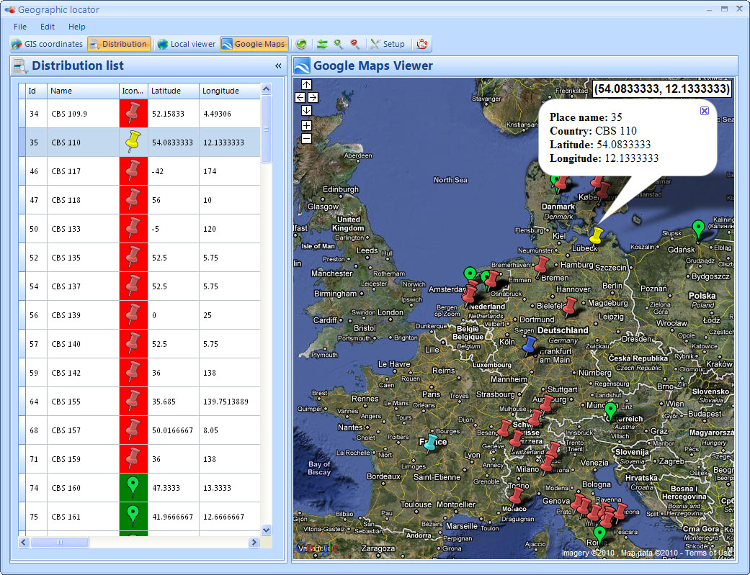
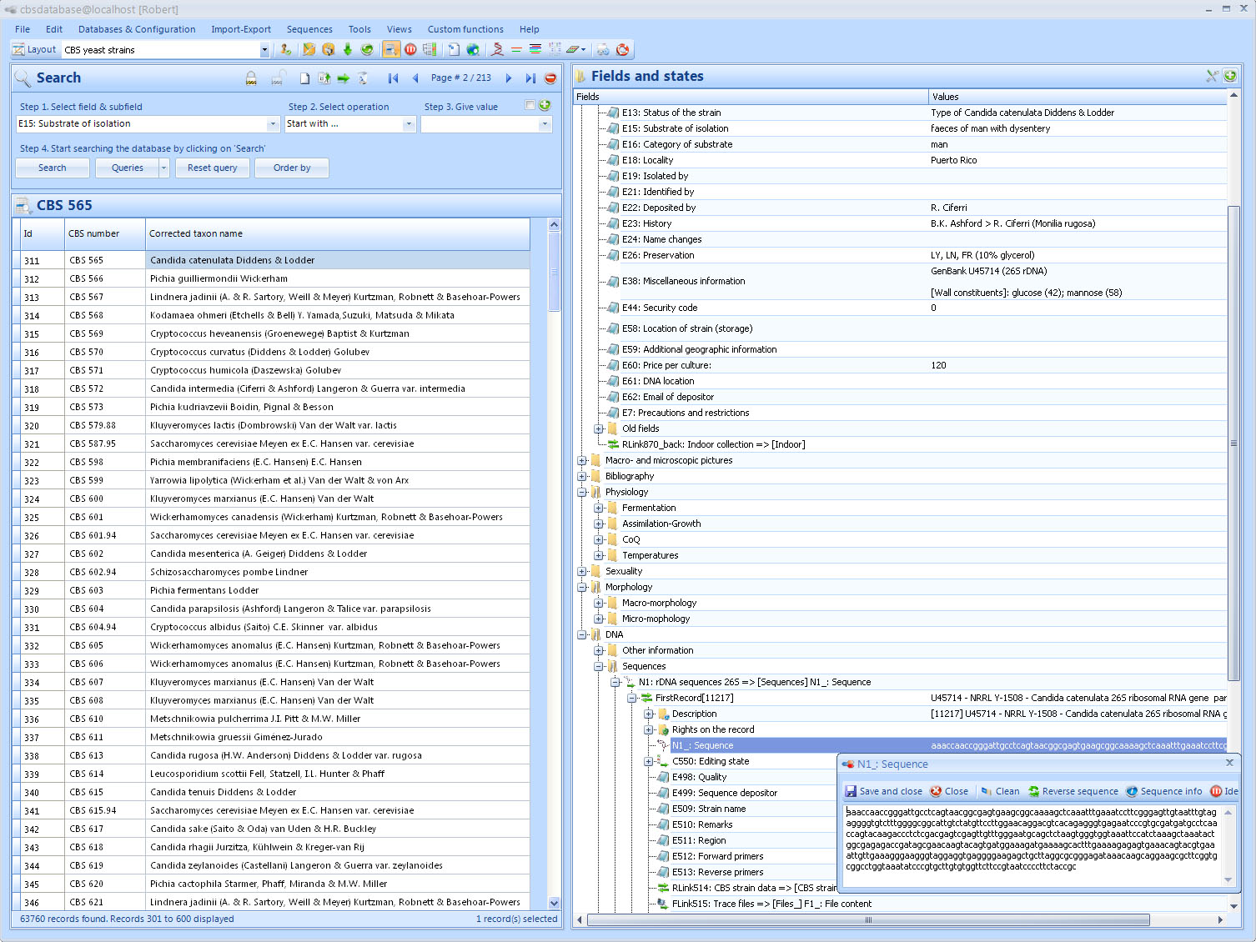
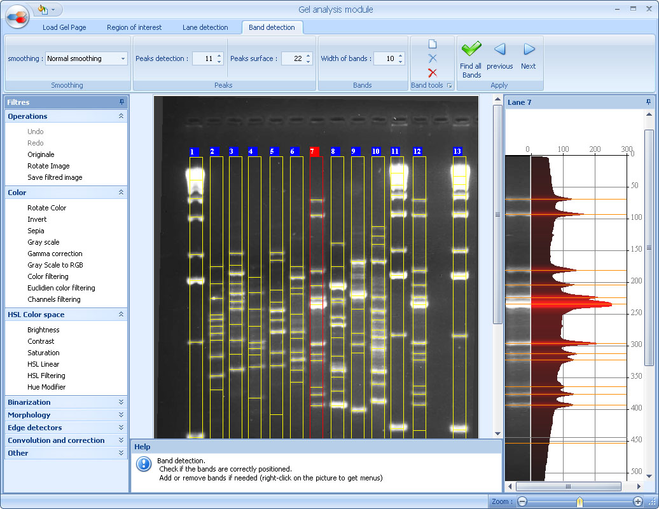
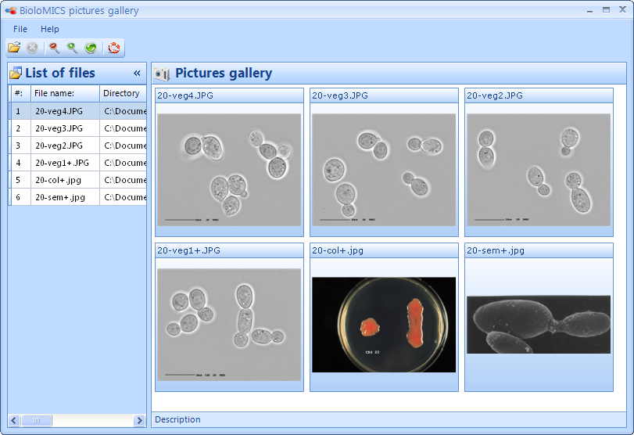
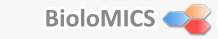
Introduction
Aim of this demonstration:
Provide an overview of BioloMICS
Outline the ‘Atlas of Living Australia’ offering for CHACM-member institutions
Notes:
Welcome, my name is Nathalie van de Wiele and I will be giving a presentation to introduce BioloMICS to you.
In 2010, CHACM identified BioloMICS as the preferred software solution for managing microorganism collection data in Australia. The Atlas of Living Australia is working to improve shared microorganism data. This involves improving digital records held by collections. The Atlas is making BioloMICS available to any CHACM members that request it.
This presentation provides an overview of BioloMICS and assistance available from the Atlas.
The BioloMICS vendor Bio-Aware is continuously improving the system day by day, and is making it as user friendly as possible

Slide 3












What is BioloMICS?
Biological collection management system
Established in 1999
Globally used
Specialised in:
Data storage/management
Data analysis
Publishing of the data
Notes:
What is BioloMICS?
BioloMICS is a biological collection management system that was originally created in 1999 and is now a globally used product.
BioloMICS is mainly focused on data storage/ data management, data analysis and publishing of the data.
The team at Bio-Aware are continuously improving the system day by day, and are making it as user friendly as possible.

Slide 4
Why BioloMICS?
High security level
Free use and support until at least 2012
Multi user access
Relational database
Virtually any data can be stored (morphological, administrative, pictures, sequence data, geographical, …)
Option to create/write own scripts
Easy import and export of data
Many analysis tools available
Online instruction movies - www.bio-aware.com
Notes:
Why use BioloMICS?
This might be a very interesting question for you all.
Well, there are some good reasons why to choose BioloMICS and how it really improves YOUR way of working in the future.
High Security Level > the system is very safe, in that everyone using the system has to be registered to use it and each user will have specific rights to the data.
This means for example not everyone is able to modify or even see some part of the data. Whereas others will have full rights to all the data available in the database.
Free use and support until mid 2012 > ALA has bought a package that includes licenses that are needed to use BioloMICS. The individual labs are assigned/allocated a license or licenses depending on their requirements.
This means that if you decide to take BioloMICS you will receive the BioloMICS software and full support for free until mid 2012. After this date you can either decide to continue and pay for the renewal of the license yourself or not continue. If you choose to not continue, this means you will keep the BioloMICS software with all your data, but there will be no support and no updates anymore from then on.
It is like buying Microsoft word, you can buy a version, you will keep the version you originally bought but won’t have access to download any newer versions that may be available.
Multi user > If you have an excel spreadsheet or an access database, it only allows one person to modify data at any given time. BioloMICS on the other hand is able to be accessed by more then one person at the same time. This multi- user access for BioloMICS depends on the quantity of licenses that you will require. For example if you have 3 licenses, this means 3 people are able to access the BioloMICS database at the same time.
Relational database > BioloMICS is a relational database which means the data is stored in many tables that are linked to each other.
Virtually any data can be shared > Morphological, administrative, pictures, sequence data, geographical
Option to create/write your own scripts > Many functions are made available in the BioloMICS software, but there might be something that is missing for you in particular. If this is the case, the BioloMICS software enables you to create your own script and add this to the main menu.
Easy import and export of data > BioloMICS allows for several types of formats that Data can be imported and exported. You can also make a template for exporting the data in a specific way.
Many analyse tools available > Pairwise and multiple alignment or classification are just some of the analysis tools that are made available in BioloMICS. More details about these tools will be discussed later on.
Online Instruction Movies > There are free online instructional movies available on the website at Bio-Aware. They explain many of the functions in BioloMICS.

Slide 5
What can BioloMICS do?
BioloMICS includes tools to:
Store and share data
Customise and secure data
Search data
Polyphasic identification and classification
Gel analysis
Laboratory Information Management System (LIMS)
Images analysis
Geographic manager
Sequence tools
Publish (to intranet, ALA and AMRiN)

Slide 6
Main interface
Movie: add new record
Notes:
This slide shows a screen shot of the Main Interface – layout.
This is the main interface of the BioloMICS software.
Most modules can be started from here
On the left side you see the grid, which contains all your records
On the right side you see the tree, which shows all the fields in the table (that you can see)
As you can see, fields can be grouped together, for example there is a folder DNA which contains a folder Sequences and Other information. These folders contain the actual fields like sequence fields.
On the right you see all the fields from one record (the selected record), but you are also able to see the information of one field in all the strains. In that case you can drag the field from the tree to the grid. As you can see here, this is done with 'corrected taxon name'.
Records can be added from this main screen - add new record
From this interface records can be added. I will show a movie how to do this
- Show movie: add new record

Slide 7
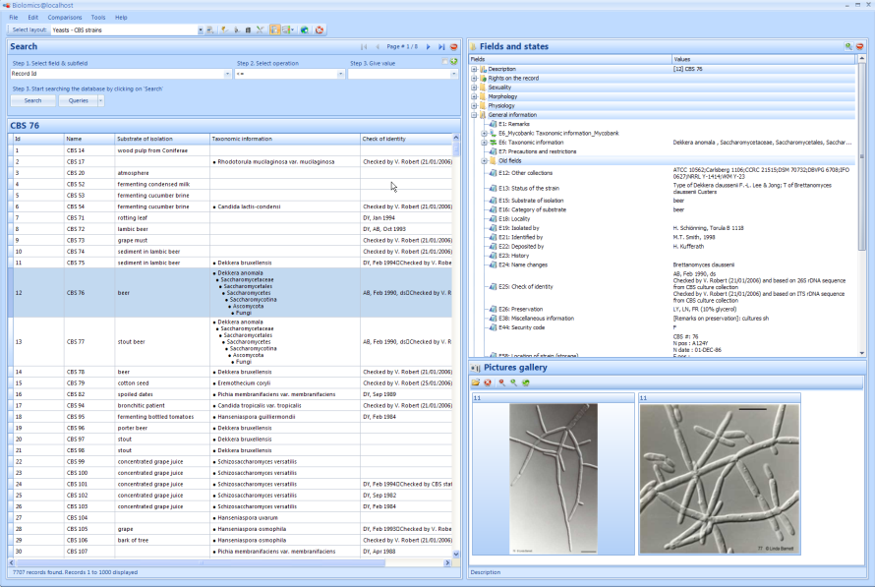
Data sharing
Connections between (n) collections
specific databases
Desktop
Database of a collection
Bibliography table
Taxon names table
Other tables
…
Strains table containing a number of fields
DNA Sequences table
Stock management table
Properties table
Host table
Database of a collection
Bibliography table
Taxon names table
Other tables
…
Strains table containing a number of fields
DNA Sequences table
Stock management table
Properties table
Host table
Database of a collection
Bibliography table
Taxon names table
Other tables
…
Strains table containing a number of fields
DNA Sequences table
Stock management table
Properties table
Host table
Notes:
Several databases can be connected to each other and data can be shared.
That is the purpose of CHACM creating a central system and share the data between the groups. A common data model will be created by ALA with the common fields that are present in each collection, for example strain name and strain number.

Slide 8
Data storage/management
Data management
Analysis Tools
Publishing Data
Database
Tables, Fields, Records
Layouts
Security and Rights
History of Changes
Search
Import and Export data
Programming Manager

Slide 9
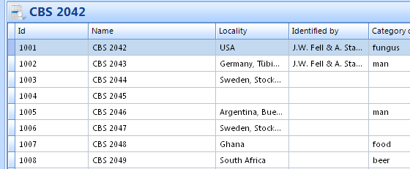
Database
Bibliography table
Taxon names table
Files tables
…
Database of a collection
Strains table containing a number of fields
DNA Sequences table
Stock management table
Properties table
Host table
Notes:
Here you see an example of a possible database in BioloMICS.
For the moment the underlying database is MySQL, but soon Oracle and MSSQL will also be made to work with BioloMICS.
Compared to for example Excel, there are many tables, which are all linked to the strain table (in this case)
Each table contains several fields, which are like the columns in Excel.
And each table contains records, which are comparable to the rows.
For example in the table strains, a field name could be locality and the value of the record will be then for example USA
It is very easy to add a new table to the database however there are some predefined tables available to choose from.
For example the
Bibliography table > contains fields like Authors, year, pages, journal,
Files table > contains any type of file, for example Word or Excel document or a picture
DNA Sequences table > Contains sequences and other information related like Primer info and region
Stock management table > can be used to keep track of the available stock and has a warning system when the stock levels are too low. It has fields like Batch number, Room, Drawer etc.
Another example of a predefined table is the Order table, this one can be used to save information about orders that are done or have to be done. This table is then linked to the Clients table, which contains all the information of the client.
ALA will help to set up default tables.

Slide 10
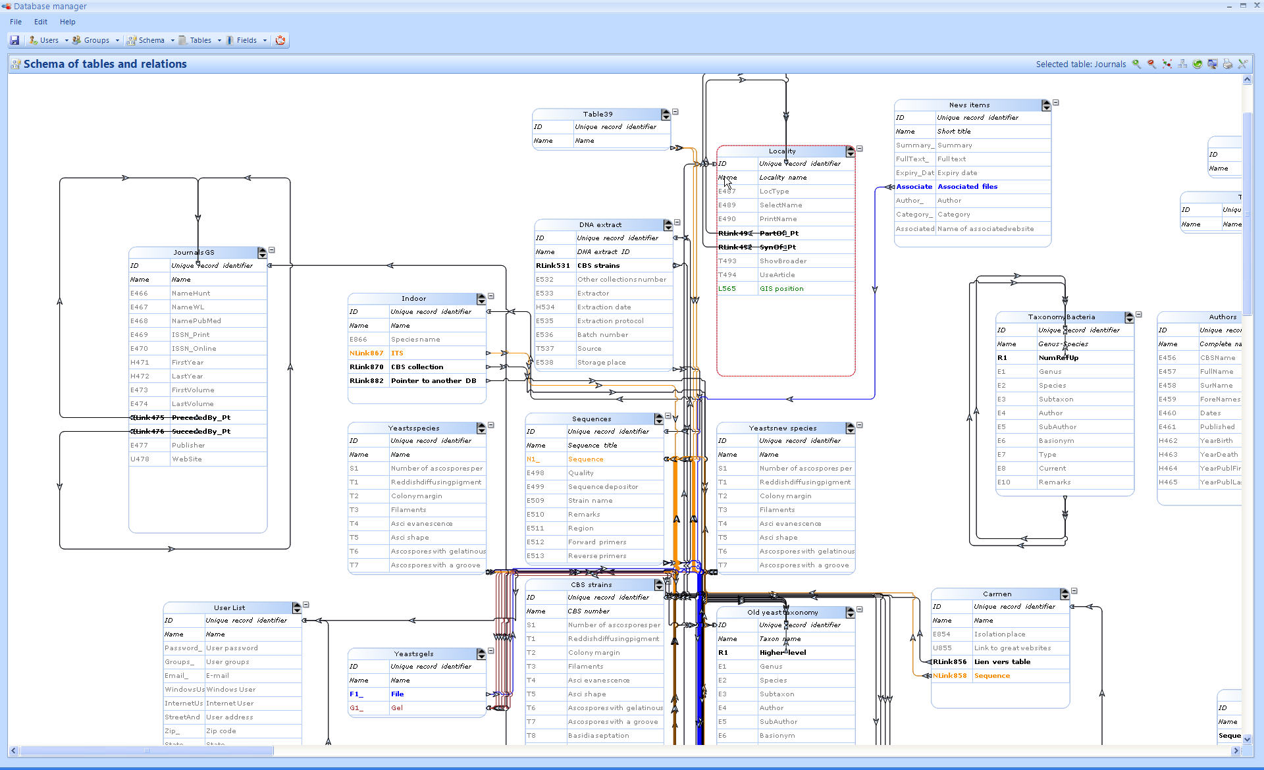
Tables, Fields, Records
Add, modify and delete:
Tables and fields: can only be modified by administrators
Records: anyone who has access to the database with writing rights
21 field types
Links between tables are visible from the database manager
Notes:
Tables and fields can be added, modified and deleted only by the administrator of the database. This is of course for security reasons.
However anyone with access to the database who has writing rights is able to add, modify or delete a record.
To add a field the administrator can choose from 21 field types. For example there is a text field for any free text, but there is also a specific field for sequences, one for saving files and one for date and time.
These different fields are created so you can use the information in the fields for identifications or comparisons.
When you choose to take BioloMICS, an ALA representative and myself will sit together with you to discuss the best way of transferring your data into the BioloMICS system.
When tables and fields are created, and links are set, the overview is visible from the database manager.

Slide 11
Layout
How to display the data
Not everyone needs to see all tables or fields
Various layouts can be created per table
Layouts can be shared
When changing a layout the data does not change
Notes:
The layout is a function where a user can set the way he wants the data to be displayed.
Because not every user registered in the database is using the software for the same purpose, not everyone needs to see all fields or tables.
For this reason a specific layout can be created to choose which fields should be visible and which are not.
Layouts can be shared by the other members as well
An unlimited number of layouts can be created for each table.
When changing a layout, a user will only change the way data will be displayed for himself and not for other users of the same database, except if that layout is shared between users.

Slide 12

Security
A login and password are required
Only registered users can access the system
Users belong to groups that have specific rights on tables, fields and records
Only the administrator can add, modify or delete a users profile or a group
Records can be temporarily protected
Notes:
The security in BioloMICS is very high which makes this software very safe for storing your data.
Access to databases is granted via a login and password, so only registered users can access the system.
Each user belongs to one or more groups that have specific rights on tables, fields and records > for example administrator, user, guest, Internet user groups
Only the administrator can add, modify or delete a users profile or a group
Anyone with writing rights can lock or unlock a record

Slide 13
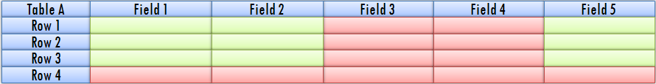
Security - Rights
Rights on tables, fields and records are given to a group of users
Three levels of access:
Read (R), Write (W), Delete (D)
Notes:
Rights on tables, fields and records are given to a group of users > not just to one user independently.
There are three levels of access: Read, Write and Delete
With these three levels you can give the rights to groups
Which means you can have: no rights 000 – read rights only R00 – read and write rights RW0 – full rights RWD
The diagram on this slide provides an example explaining the rights a little better:
You have Table A, which contains 5 fields and 4 rows
Group (G1): RWD rights on table A
RWD rights on F1, F2 and F5 &
no rights (000) on F3 and F4
→ F3 and F4 will NOT be visible
RWD rights on R1, R2 and R3 &
no rights (000) on R4
→ R4 will NOT be visible
>> Conclusion: if you have rights on a table, this does not mean you have the rights to see all fields and records!

Slide 14
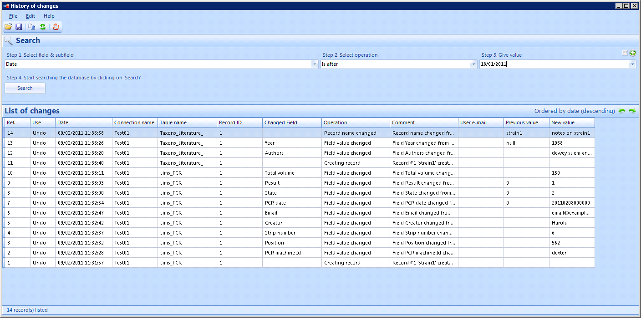
History of changes
Every modification made to a given database is recorded
The administrator can search the tracking system and undo or redo a number of actions
Notes:
With the history of changes, ever modification made to a given database is recorded.
The administrator can search the tracking system and undo or redo a number of actions.
All information of the modification is visible, such as date of change, table, field and record of change, new/previous value, who made the change etc.
For example: it’s possible to search for all changes made by a given user between March and November of a given year.

Slide 15
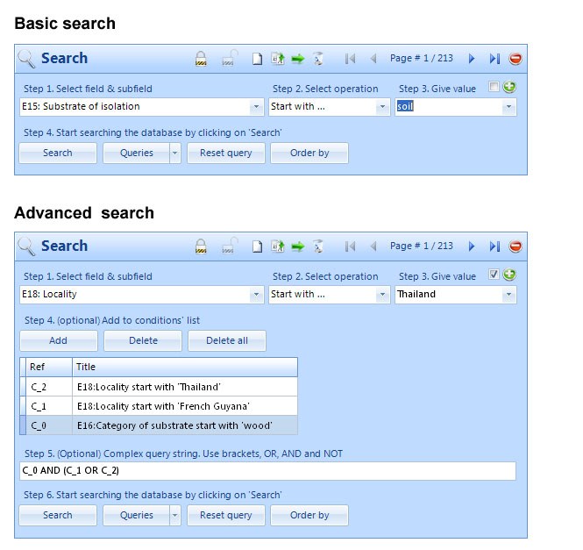
Search
Notes:
There are two ways available for using the search function; you can either use the basic search or the advanced search.
For the basic search, only one question at a time can be set (so for example show all records that has a value that starts with ‘soil’ in the field ‘substrate of isolation’.
There are several operations to select from: start with, contains, exact match, value is undefined, name is duplicated.
For the advanced search, several questions or conditions can be set at the same time, for example… (see picture)
Queries can be saved and re-used later
Of course, making a search on exact match is the fastest way to search.

Slide 16
Import data
Everyone with writing rights can enter new data
Large amounts of data can be imported as tab-delimited (from Excel for example)
Sequences can be imported in fasta format
>Species name|collection number| other information…
ACCTCTTCGATGGCTAGATCGGATCGGATCGATCGATGCT
Images, text files and PDFs can be attached to records
Data can be appended, merged or replaced
Notes:
Everyone with writing rights can enter new data into fields of existing records or add a new record
Large amounts of data can be imported as tab-delimited (from Excel for example where each cell has a value or in Word, when the different values are separated by a tab) –
Sequences can be imported in fasta format
Data can be appended, merged or replaced

Slide 17
Export data
All data can be exported using standard formats such as Tab delimited, text, MS Excel, MS Word, Fasta, etc.
Users can define own formats and create reporting templates
Export to ALA and AMRiN will be part of the standard configuration
Notes:
All data can be exported using standard formats such as Tab delimited, text, MS Excel, MS Word, Fasta, etc.
Users can define own formats and create reporting templates
For example you can export the field names only, paste this into a word document. Then you can add additional information that you want to see in your monthly or year report. Save this as the template. And then export the data from the database with each time using this template format.
You will have the same look each time you make the report, and the newest data.

Slide 18
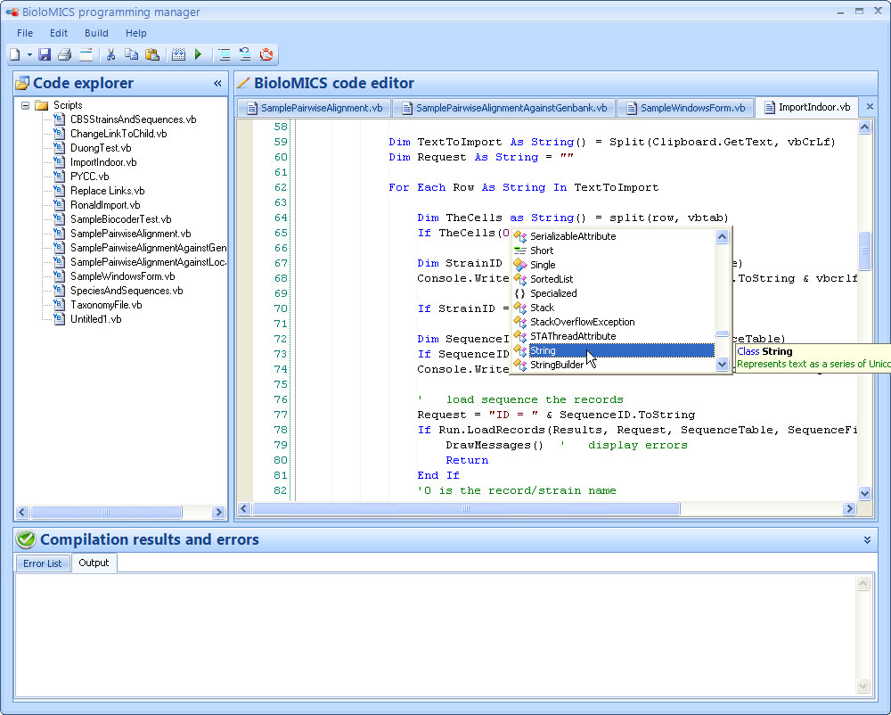
Programming manager
Visual Basic or C#
Specific functions are developed
Add script to main menu
Notes:
The programming manager is created because sometimes clients have specific needs, which are not applicable for others. With this function you have the freedom to add whatever function you want.
The scripts can be written either in Visual Basic or in C#.
Specific functions are developed for writing the script in BioloMICS.
The script can be put into the main menu of BioloMICS to run it frequently.

Slide 19
Analysis tools
Data management
Analysis Tools
Publishing Data
Polyphasic identification
Polyphasic classification
Gel analysis
Laboratory Information Management System (LIMS)
Images analysis
Geographic manager
Sequence tools
Pairwise alignment
Multiple alignment and trace file edition
Notes:
This was previously mentioned earlier in the presentation, in the part about the Data Management.
I will briefly explain the following data Analysis Tools of BioloMICS.
•Polyphasic identification
•Polyphasic classification
•Gel analysis
•LIMS
•Images analysis
•Geographic manager
•Sequence tools

Slide 20
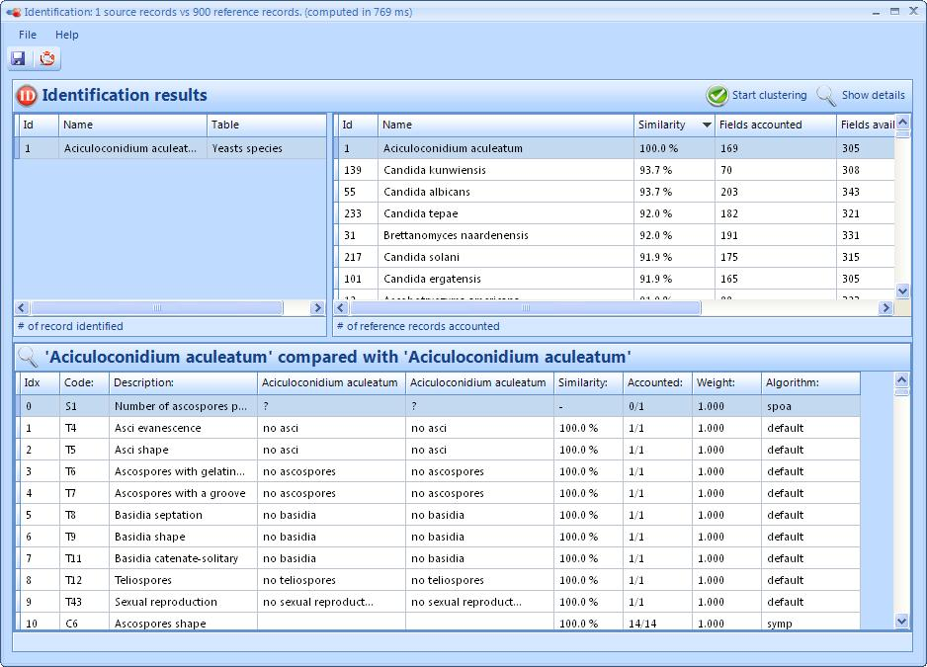
Polyphasic identification
Unknown record <-> Unlimited # reference records
Any selection of characters or fields
Notes:
Polyphasic Identification means that unknown records can be compared with an unlimited number of reference records on the basis of any selection of characters or fields.
For the different field types, different algorithms are available to choose from. You can also set other parameters such as the weight, when you think that the values of one particular field are more important than the other.

Slide 21
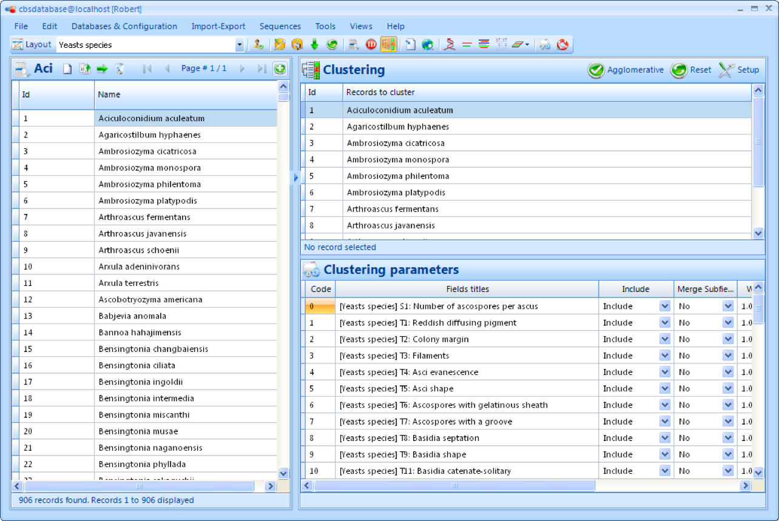
Polyphasic classification
Set of records
Any selection of characters or fields
Notes:
Polyphasic Classification means that a set of records can be compared on the basis of any selection of characters of fields.
The selected records can come from different tables.
Nine different algorithms have been implemented (UPGMA, UPGMC, WPGMA, WPGMC, Single and Complete Linkages, Ward, Lance&Williams flexible method, and Neighbor Joining)

Slide 22
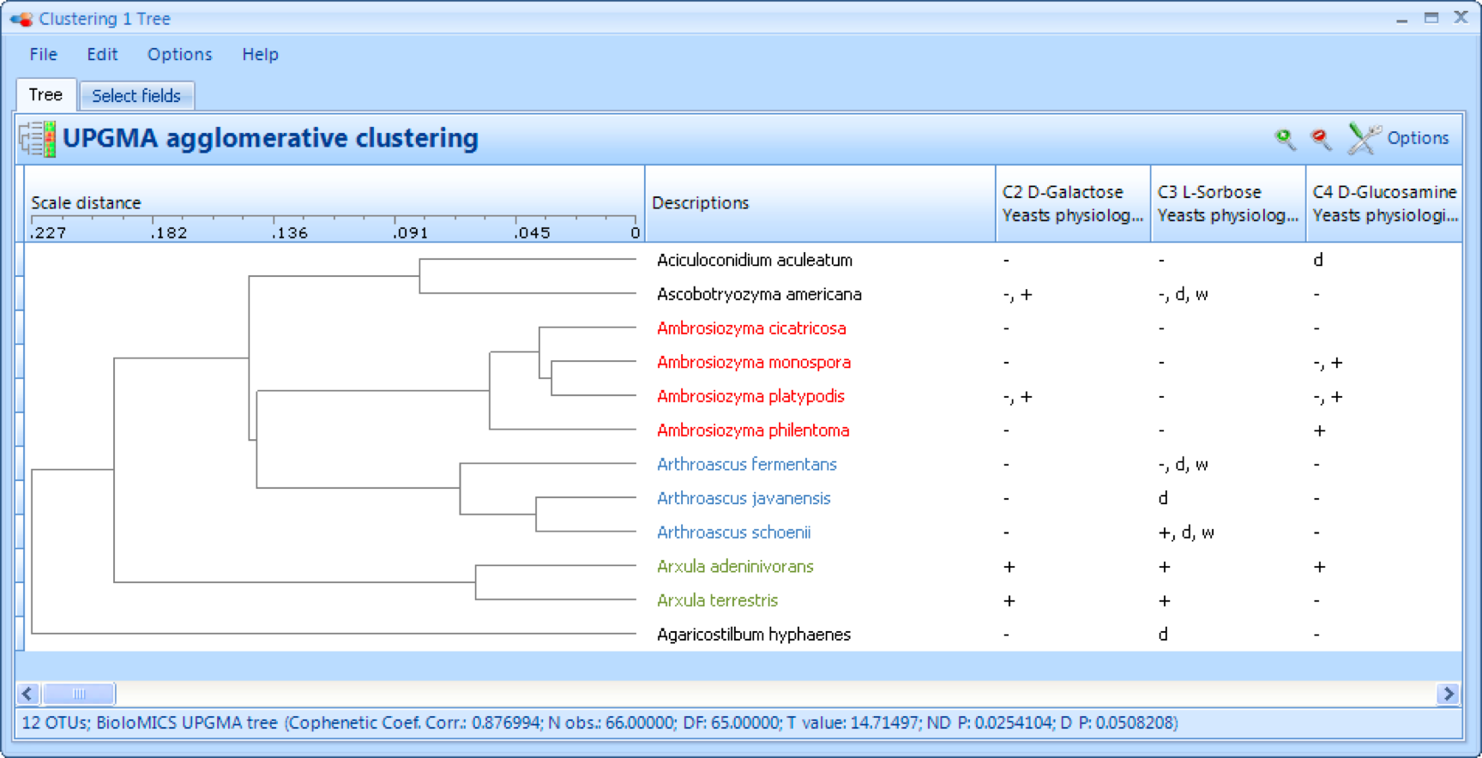
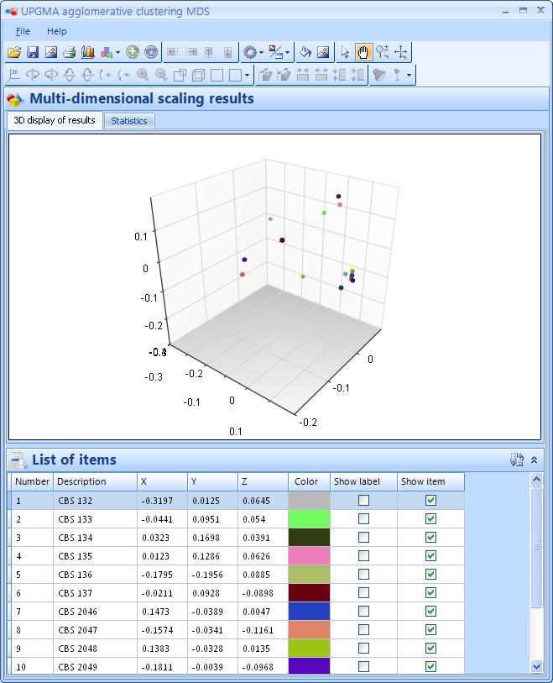
Presenting the results
Agglomerative clustering tree
Multi-Dimensional Scaling
Notes:
Here you see an agglomerative clustering tree based on the algorithm UPGMA.
Additional fields can be displayed next to the tree.
And some other function can be set such as font colour, size, background colour etc
The results can also be presented in 3D. Many parameters are available for example; you can make one particular group of selected records one colour and another group another colour. This will enable you to display the results in a recognisable format so that you can easily distinguish between the information being displayed.

Slide 23
Gel analysis
Any format can be opened, filtered and modified
Automatic lane and band detection
Notes:
Within BioloMICS you can analyse an electrophoresis gel.
Any format of pictures can be opened, filtered and modified.
On this picture you see the lanes of your gel and the bands. These can be retrieved automatically. All you have to do is check your lanes, and be sure that all the bands in each lane are selected.
Then you give the molecular weight of the reference lanes that you used.
And automatically the software will give the molecular weights of all the bands.
These results can be imported into the BioloMICS database and used for identification and classification purposes

Slide 24
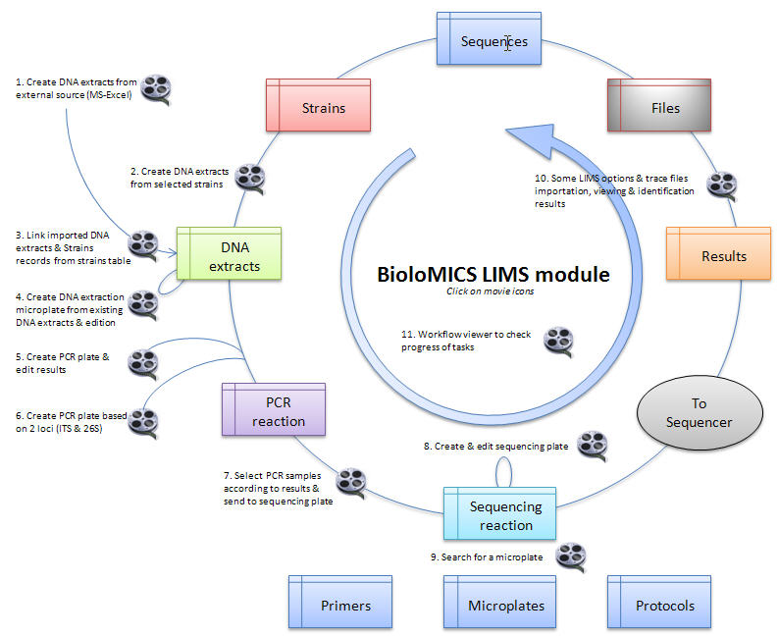
LIMS
Laboratory Information Management System
To manage and track sequencing operations
Notes:
This is a very advanced tool in BioloMICS and was created to manage and track sequencing operations.
You go from DNA extraction to PCR and sequencing reactions. When you get the sequences back from the sequencer, alignments of the trace files will be made automatically and the results will be inserted into the database.

Slide 25
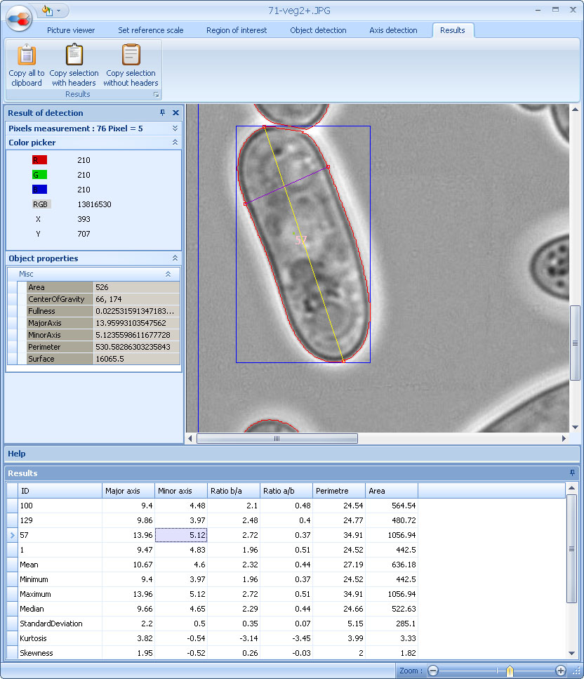
Image analysis
Measurements of objects present on a picture
Notes:
Pictures that are saved in the database can be analysed in this module.
It allows measurements of objects that are present on a picture.
Several parameters of the objects on the picture can be measured automatically or manually, such as length, width and surface
There is also a multi picture viewer, which allows pictures that are not present in the database to be added.

Slide 26
Geographic manager
Locate strains on the map by lat/long or text field
Notes:
With the Geographic Manager, strains can be located on the map by using the latitude and longitude or from a text field like Place of Origin.
The distribution of strains can be recorded and can be exported to Google Earth.
Strains can be grouped by using specific colours and symbols.
One can manually add latitude and longitude data without changing the underlying database.
Latitudes and longitudes can also be found by entering the place name.

Slide 27
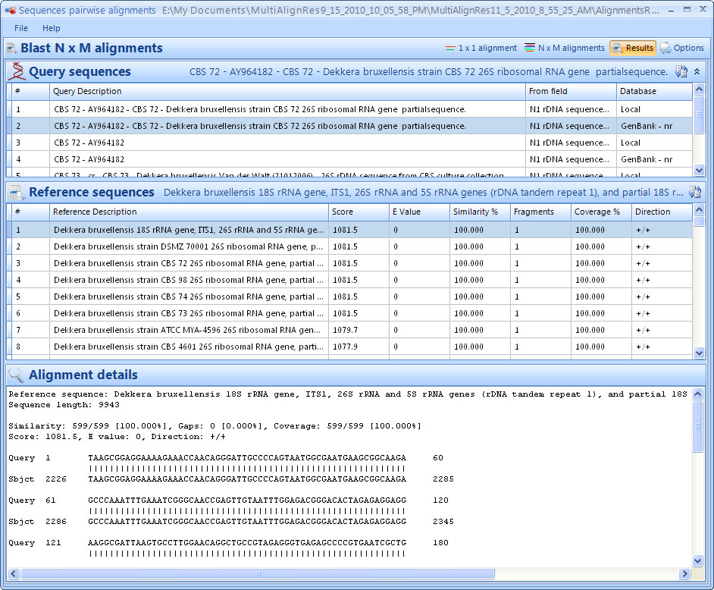
Pairwise alignment
Align one sequence against another
Few sequences against Genbank or local database
Notes:
Pairwise Alignment can be used to align one sequence against another or to align a few sequences against Genbank or the Local Database.
Please note that Results are always saved and can be re-opened at any time.

Slide 28
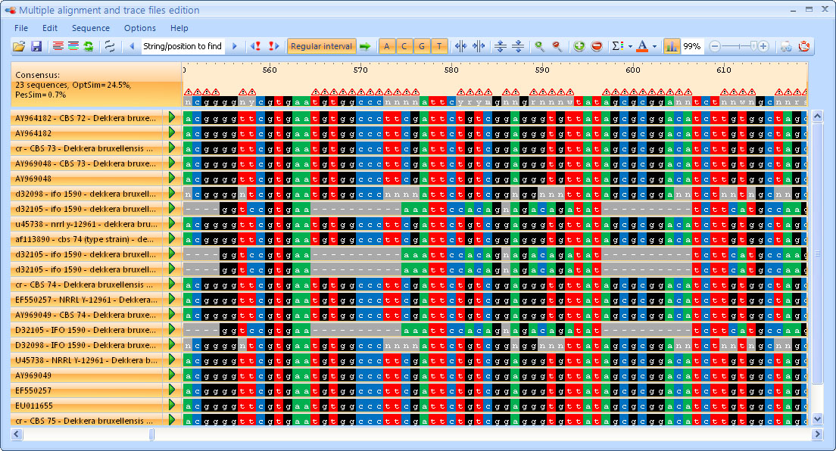
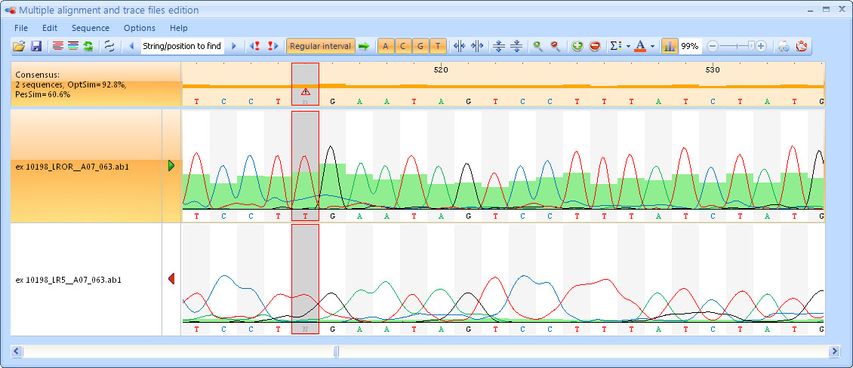
Multiple alignment & trace file edition
Notes:
This module is to align multiple sequences at the same time.
Standard formats can be loaded such as ABi file, SCF files and fasta files.
There are many options to edit the alignment, and the results can be saved into the database and re-opened at any time.

Slide 29
Publishing Data
Data management
Analysis Tools
Publishing Data
To Intranet
To ALA and AMRiN

Slide 30
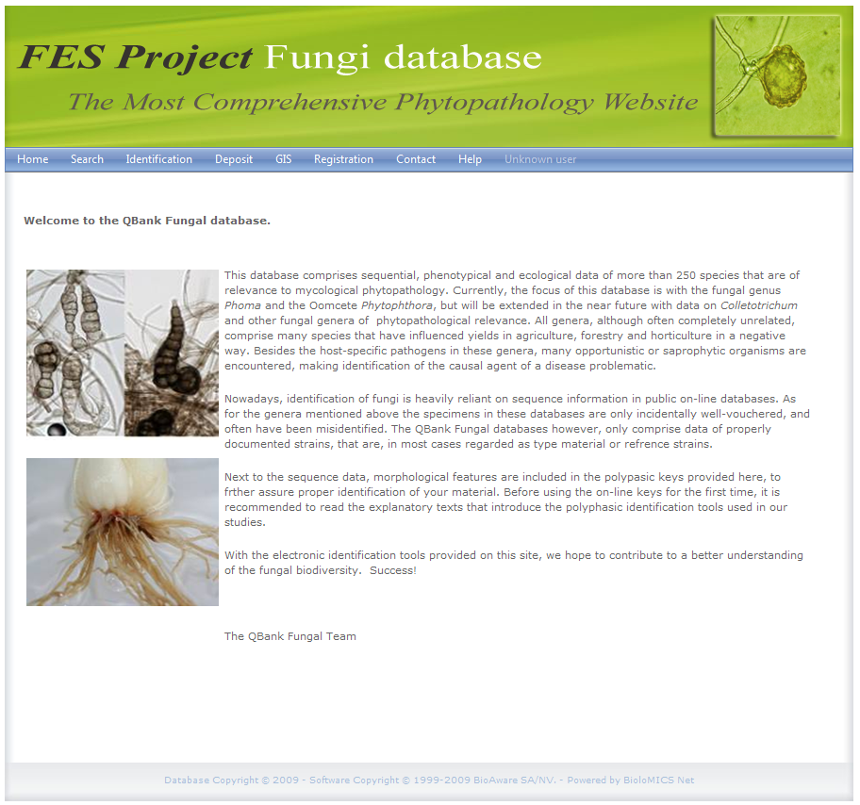
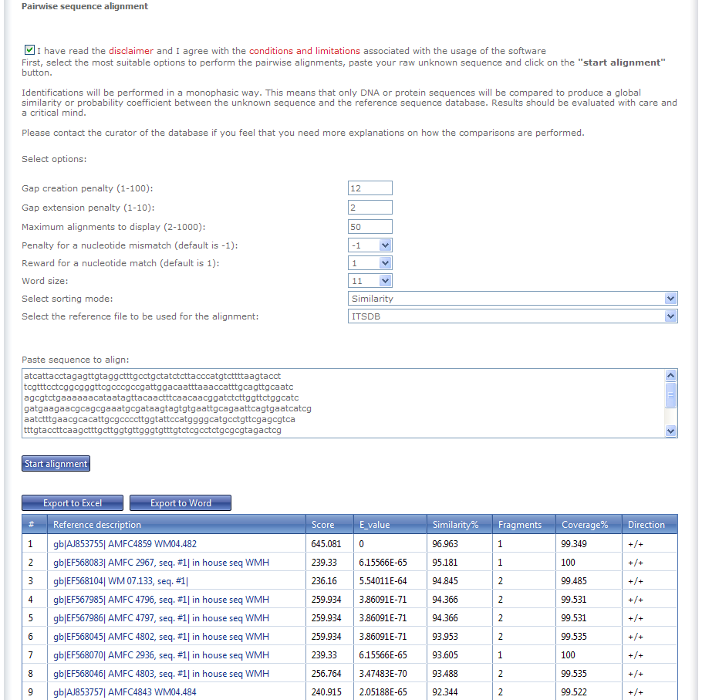
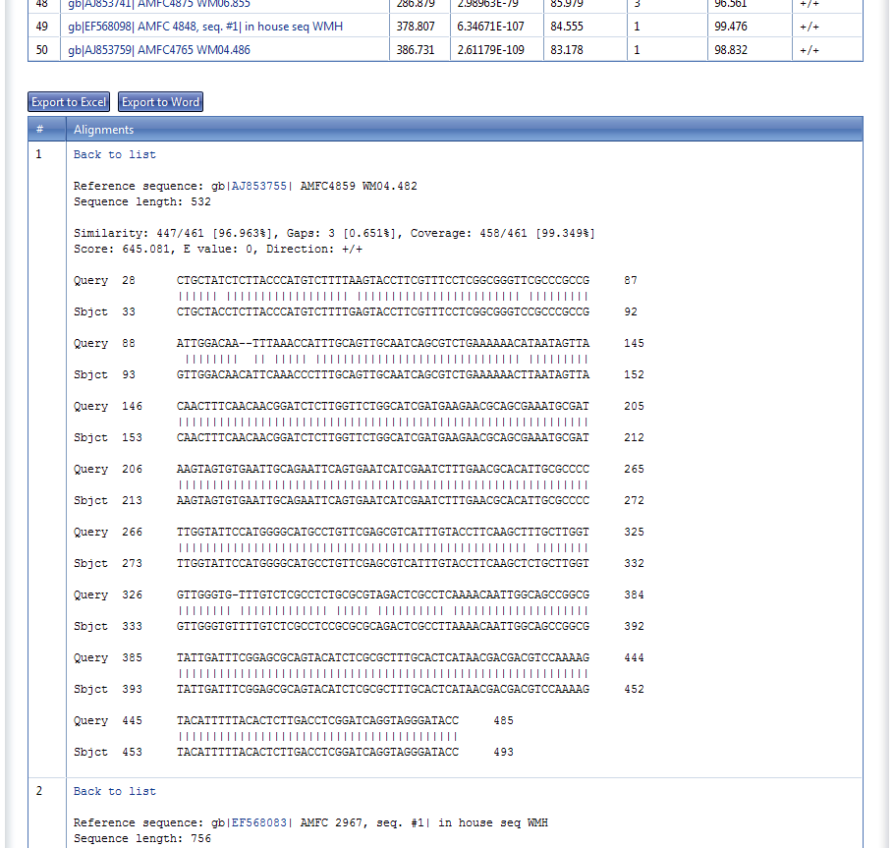
Publishing data to intranet
You decide which tables and records to publish
Notes:
Managers and curators of the database can decide which tables and records are to be published on the website.
When data is changed from the desktop version of the software, the website is automatically updated.
The style of the website can be customised by the curator.
The people that use/visit the website are able to search the data that is made public.
And Pairwise alignments, identification and classification are all possible.

Slide 31
Publishing data to ALA and AMRiN
Is part of the standard configuration
Script available through ‘Programming Manager’
Two modes:
Automatic (scheduled job)
Manual (run script to produce file, then upload at http://www.ala.org.au/share/share-data/)

Slide 32
The Atlas is offering to:
provide BioloMICS licences to organisations that wish to adopt it
paying licence maintenance fees to at least 2012
assist with installing and implementing BioloMICS
assist with migrating existing databases or electronic files to BioloMICS
provide initial training in BioloMICS
advise on establishing a web presence for microorganism collections using BioloMICS, if required
assist to export data from collection databases for sharing through the ALA site and AMRiN.

Slide 33
Summary
Data is kept safe due to high security rules
Multiple users can access the data at the same time
Data can be shared between labs
There are many Analysis Tools available in the software
It is available for your use for free.
So, why not take it?
Notes:
Summary
Data is kept safe due to high security rules.
Multiple users can access the data at the same time.
Data can be shared between labs.
There are many Analysis Tools available in the software.
It is available for your use for free until mid-2012
After this date, you can either choose to pay yourself and continue receiving the latest updates and support, or you can choose not to. In any case the software as you have it can still be used, also without the updates.
> So, why not take it?

Slide 34
Where to get more information
These slides:
(ala.org.au)
BioloMICS support:
http://www.bio-aware.com/
Atlas of Living Australia:
http://www.ala.org.au/support/
support@ala.org.au
Nathalie van de Wiele:
nathalie@vdwiele.com
Notes:
Thank you for your attention!
If you have any questions you can always contact ALA or me via email.

Slide 35
The end
Any questions?
Notes:
This brings us to the end of the presentation on BioloMICS and I would like to thank you all for your attention this morning/afternoon.
Are there any questions?

Slide 36







The Atlas of Living Australia Participants
The Council of Heads of Australian Faunal Collections (CHAFC)
The Council of Heads of Australian Entomological Collections (CHAEC)
Council of Heads of Australian Collections of Microorganisms (CHACM)
The Council of Heads of Australasian Museum Directors (CAMD)
The Atlas is funded by the Australian Government under the National Collaborative Research Infrastructure Strategy and further supported by the Super Science Initiative of the Education Investment Fund

